Slide 1
Pdf File Structure, Introduction
PDF File
%PDF-1.0
%âãÏÓ
…
xref
0 40
0000000000 65535 f
0000000016 00000 n
0000000123 00000 n
0000000345 00000 n
...
startxref 12345
%%EOF
a
j
2 0 obj<<
/Type/Pages
/Count 2
/Kids[ 7 0 R 16 0 R]
>>endobj
g
3 0 obj<<
/Type/Catalog
/Pages 2 0 R
>>endobj
h
c
i
f
d
trailer<<
/Size 40
/Root 3 0 R
...
>>
e
b

Slide 2
Linearised File Structure
PDF File
%PDF-1.1
%âãÏÓ
1
a
P
a
r
t
1
:
O
b
j
e
c
t
s
n
e
e
d
e
d
f
o
r
P
a
g
e
1
43 0 obj<<
/Linearized 1.0
/L 54567
/H [475 598]
/O 44
/E 5437
/N 11
/T 52786
>>endobj
2
3
c
xref|
43 14
0000000052 000000 n
0000000392 000000 n
...
4
d
trailer<<
/Size 57
/Prev 52776
/Root 45 0 R
>>
e
h
startxref
0
%%EOF
i
45 0 obj<<
/Type /Catalog
/Pages 42 0 R
>>endobj
j
5
l
44 0 obj Page 1
P
A
R
T
2
:
R
e
s
t
k
42 0 obj Pages 1
1 0 obj Page 2
f
xref
0 43
0000000000 65535 f
...
trailer<</Size 43>>
startxref
257
%%EOF
g
b

Slide 3
Pdf File Structure, Cross Reference Tables
PDF File
%PDF-1.6
%âãÏÓ
…
xref
0 74
0000000000 65535 f
0000000016 00000 n
0000050772 00000 n
startxref 67964
%%EOF
a
f
62 0 obj<<
/Type /Xref
/Size 1821
/W[ 1 4 2]
/Root 1 0 R
/Info 63 R
/ID [<160c...><160c...>]
/Filter/FlateDecode
/Length 3342>>
Stream...endstream
endobj
c
d
trailer<<
/Size 74
/Root 73 0 R
/Info 63 0 R
/Prev 114629
/ID [<160c...><160c...>]
>>
e
b

Slide 4
Pdf File Structure, Encryption
PDF File
%PDF-1.4
%âãÏÓ
…
xref
0 74
0000000000 65535 f
0000000016 00000 n
0000050772 00000 n
startxref 67964
%%EOF
a
f
1 0 obj <<
/Filter/Standard
/V 2
/R 3
/P -1852
/Length 128
/O <3d7d82...>
/U <f15047...>
>> endobj
c
d
trailer<<
/Size 74
/Root 73 0 R
/Info 63 0 R
/Encrypt 1 0 R
/ID [<160c...><160c...>]
>>
e
b

Slide 5
Pdf Object Hierarchy
Trailer
Prev
Root
Encrypt
Info
Catalog
Pages
Pages
Parent
Kids
Resources
Page
Parent
Content
Resources
Content
stream
Information
Root
Info
Font
ToUnicode
1 to 1
1 to many
optional

Slide 6
Page Tree
tree leave
tree branch
Obj 63
Page
Parent
Obj 32
Page 1
tree root
Obj 32
Pages
Parent
Obj 19
Kids
Obj 63
Obj 42
Obj 8
Obj 19
Pages
Parent
Obj 12
Kids
Obj 32
Obj 25
Obj 12
Catalog
Pages
Obj 19
Obj 42
Page
Parent
Obj 32
Page 2
Obj 25
Page
Parent
Obj 19
Page 4
Obj 8
Page
Parent
Obj 32
Page 3

Slide 7
Algorithm 2: Computing an encryption key
Padded user password
Repeat 50 times with Encrypt.Lenght bits
Encrypt.O
MD5
Hash
P
General
Encyption
Key
Trailer.ID

Slide 8
Algorithm 1: Encryption of data using the RC4
General
Encyption
Key
Repeat 20 times
RC4
Key
Data
Object Id
MD5
Hash
XOR with
Iterator
Object Generation
Readable text
Encrypted text
Decryption of data using the RC4
General
Encyption
Key
Repeat 20 times
RC4
Key
Data
Object Id
MD5
Hash
XOR with
Iterator
Object Generation
Encrypted text
Readable text

Slide 9
Algorithm 5: Computing the encryption dictionary’s U (user password) value
Repeat 20 times
RC4
Key
Data
General
Encyption
Key
XOR with
Iterator
Encrypt.U
Padded user password
MD5
Hash
Trailer.ID
Repeat 20 times
Algorithm 6: Authenticating the user password
Repeat 20 times
RC4
Key
Data
General
Encyption
Key
XOR with
Iterator
Stored
Encrypt.U
yes
valid
Equal ?
Calculated
Encrypt.U
no
invalid
Padded user password
MD5
Hash
Trailer.ID
Repeat 20 times

Slide 10
Algorithm 3: Computing the encryption dictionary’s O (owner password) value
Repeat 50 times
Repeat 20 times
RC4
Key
Data
Padded owner password
MD5
Hash
XOR with
Iterator
Padded user password
Encrypt.O
Repeat 20 times
Algorithm 7: Authenticating the owner password
Repeat 50 times
Repeat 20 times
RC4
Key
Data
Padded owner password
MD5
Hash
XOR with
Iterator
Use Padded user password as input to Algorithm 6
Encrypt.O
Padded user password
Repeat 20 times

Slide 11
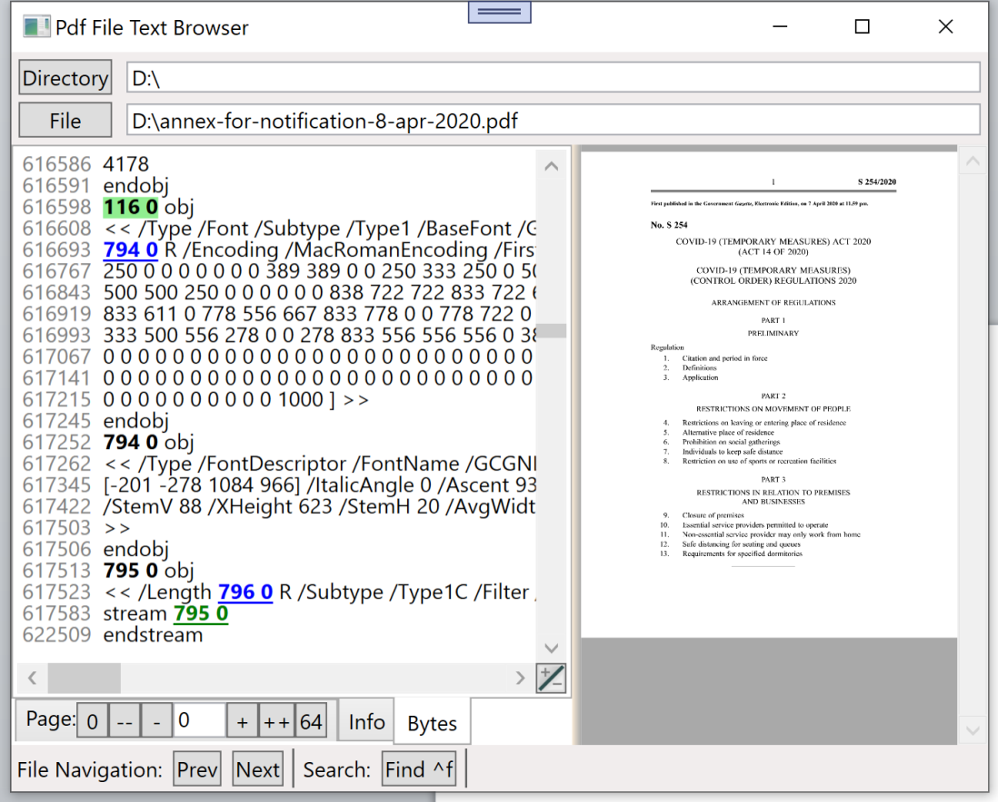
Components of MainWindow
MainWindow
AdrLabels
Marked Anchor
TextViewer
TextViewerGlyph
TextViewerSelection
PdfViewer
Anchor
Link
Stream
Visible pdf file content when the ‘Bytes’ tab is selected

Slide 12
Coordinates
X
Document
TextStartDocuX
0
13
34
45
56
85
93
113
127
139
147
156
163
176
189
199
214
Text
VerticalScrollbar.Value
View
HorizontalScrollbar.Value
Border
AdrLabel (Byte offset of first line character from start of pdf file)
Y
Document: Covers all characters of AdrLabels and pdf content, just used as coordinates, not stored, uses line number for y coordinates and document pixels for x coordinates.
Text: Contains all characters (incl. formatting chars) of pdf text. Uses char number for x and line number for y.
View: TextViewer window, shows part of AdrLabels and pdf content on screen, uses screen pixels for x and y.

Slide 13
TextViewer
Loading TextViewer with pdf file bytes
TextViewer events and renderer
MainWindow.navigate()
PdfParser constructor()
tokeniser.VerifyFileHeader()
tokeniser.FindPages()
findXrefTable()
readXrefTable()
readTrailers()
read DocumentID, Encrypt, DocumentInfo, Root, Pages token
addPages()
addInfo()
addBytes()
bytesTextViwer.Load(tokeniser)
textStore.Reset()
PdfToTextStore.Convert(tokeniser, textStore)
format tokeniser.PdfBytes and copy to testStore
TextViewer
PdfParser constructor()
tokeniser.VerifyFileHeader()
tokeniser.FindPages()
findXrefTable()
readXrefTable()
readTrailers()
read DocumentID, Encrypt, DocumentInfo, Root, Pages token
addPages()
addInfo()
addBytes()
bytesTextViwer.Load(tokeniser)
textStore.Reset()
PdfToTextStore.Convert(tokeniser, textStore)
format tokeniser.PdfBytes and copy to testStore

Slide 14
Scrollbars control which text gets displayed
User clicks on VertScrollbar
Mouse
Scroll
verticalScrollbar
Minmum: 0
Value: first line to display
LargeChange: number of lines displayed
Maximum: total lines –
LargeChange
TextViewer
Keyboard
Home
PageUp
PageDown
End
TextViewerSelection
OnRenderContent()
TextViewerGlyph
OnRenderContent()
User clicks on Link
User clicks on HorScrollbar
horizontalScrollbar
Minmum: 0
Value: pixel of first char to display
LargeChange: pixel width of View
Maximum: document pixel width –
LargeChange
Keyboard
Ctrl PageUp
Ctrl PageDown

Slide 15
Main WIndow
TextViewer
TextStore
TextViewerGlyph
TextViewerSelection
Load()
Reset()
Reset()
Reset()
InvalidateVisual()
Append()
MeasureContentOverride()
MeasureContentOverride()
MeasureContentOverride()
ArrangeContentOverride()
ArrangeContentOverride()
ArrangeContentOverride()
OnRenderContent()
OnRenderContent()
OnRenderContent()
Mouse
Wheel
SetVerticalScrollbar()
SetViewLines()
Keyboard
VScrollBar_ValueChanged()
PageUp,
Down, …
Executed after TextViewerGlyph, but drawn under TextViewerGlyph
Not visible
On top of TextViewer

Slide 16
TextViewerGlyphDrawer DecodeState
plain
add ‘[x?‘
add ‘[‘
‘[‘
‘]‘
add ‘]‘
add ‘]x‘
illegal ‘x’
‘[‘
next char
‘]‘
‘x‘
next char
legal
Draw normal text
Draw formatted text
format
add ‘[x?‘
add ‘[‘
‘[‘
‘]‘
add ‘]‘
add ‘x‘
‘x’
‘[‘
‘]‘
‘x‘
next char
next char

Slide 17
TextViewer
TextViewer
TextStore
LineStarts
Chars
0
1
2
3
4
5
0
3
6
9
12
15
Aaa
Bbb
Link
Stream
456
Display
displayLineIndex: 0
TextViewerGlyph
TextViewerObjects
Link
Stream
Link
Stream
TextViewerSelection
First character
position of this line
absolutLineIndex
TextStore contains all characters of a document
TextViewerGlyph calculates the width of the characters and paints them to the screen
TextViewerSelection draws blue rectangles under characters selected by user
TextViewerObjects holds information about some displayed characters, showing a pdf stream or a link to another part in the document
TextStore
Stores all characters in chars, a char[], which gets reused by ever document
The int[] LineStarts stores for every line a character index into chars where that line starts. LineStarts[0] is always 0. LineStarts has 1 more line entry than the number of lines in the document. It points to the first character in chars after the document ends.
Line Indexes
Lines related to the TextStore are counted from the beginning of the document and are called absolute lines.
Lines counted from the first displayed line are called display lines. For example the mouse position is first translated to a display line index.
Most lines in the code are absolute lines.

Slide 18
TextViewer
TextViewerGlyph
SetDisplayLines()
OnRenderContent()
TextViewerObjects
AddLink()
AddStream()
TextViewer
TextViewer_SizeChanged
ScrollBar_ValueChanged
TextViewer_MouseMove
when left mouse button is
pressed, text selection changes
TextViewerSelection
SetDisplayLines()
SetSelection()
OnRenderContent()

